Slide 1
Web Presence Project Crafting & Compelling Website Analysis, Audit and Recommendations
MBE11 | SHIYAM SUNDAR S

Slide 2
Task 1 – Company Selection
Infosys Limited:
Founded in 1981, Infosys is a global leader in technology services and consulting.
Headquartered in Bengaluru, India, it provides business consulting, information technology, and outsourcing services.
Key Offerings:
Digital Transformation Services: Helping businesses adopt cutting-edge technologies.
Cloud Services: Cloud migration, management, and solutions.
Artificial Intelligence & Automation: AI-driven business solutions.
Enterprise Applications: ERP, CRM, and other enterprise-level software services.
Cybersecurity Solutions: Comprehensive security services.

Slide 3
Task 2 – Product and Service Descriptions
Finacle:
Comprehensive banking solution for core banking, payments, and digital banking.
Helps banks streamline operations, enhance customer experience, and adopt digital strategies.
Modular architecture allows integration with modern technologies and supports new models like open banking.
EdgeVerve:
Focuses on AI-powered automation and business process transformation.
Key solutions: AssistEdge (end-to-end automation and RPA) and TradeEdge (supply chain visibility).
Enables businesses to automate processes, enhance decision-making, and accelerate digital transformation.

Slide 4
Task 2 – Product and Service Descriptions
Infosys Cobalt:
A cloud ecosystem designed for secure cloud adoption across public, private, and hybrid environments.
Provides 14,000+ cloud assets and accelerators to build, manage, and scale cloud solutions.
Supports cloud-native development, digital infrastructure, and AI-driven innovations.
Infosys Nia:
Advanced AI platform offering machine learning, deep learning, and natural language processing capabilities.
Automates business processes, delivers data-driven insights, and enhances decision-making.
Used for intelligent automation, big data analytics, and predictive modeling.

Slide 5
Task 2 – Product and Service Descriptions
Infosys Digital Experience:
Enhances customer engagement through personalized digital experiences.
Uses data analytics, customer journey mapping, and design thinking to improve user experience across digital platforms.
Focuses on creating seamless omni-channel experiences to improve customer satisfaction and loyalty.

Slide 6
Task 3 – Website Platform Identification
The platform on which the Infosys website is developed includes various technologies and frameworks, as shown in the screenshot. Here are the findings:
CMS: Adobe Experience Manager
Development: Emotion, styled-components
Programming Language: Java
Cloud Services: Amazon Web Services (AWS)
UI Framework: Bootstrap
JavaScript Frameworks: React, Adobe Client Data Layer
Tag Managers: Adobe Experience Platform Launch, Google Tag Manager
Load Balancers: Amazon ALB

Slide 7
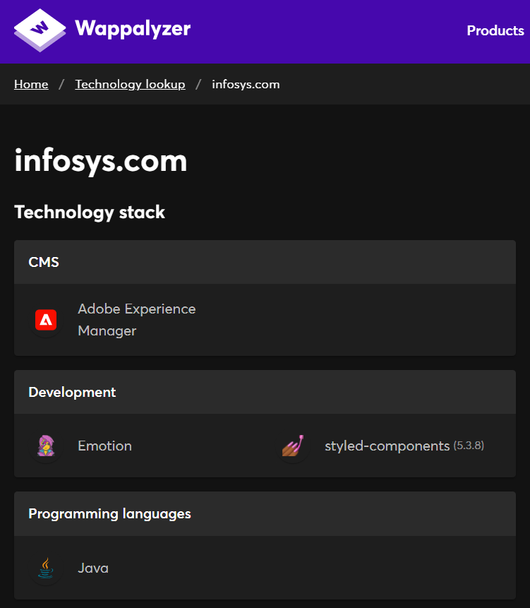
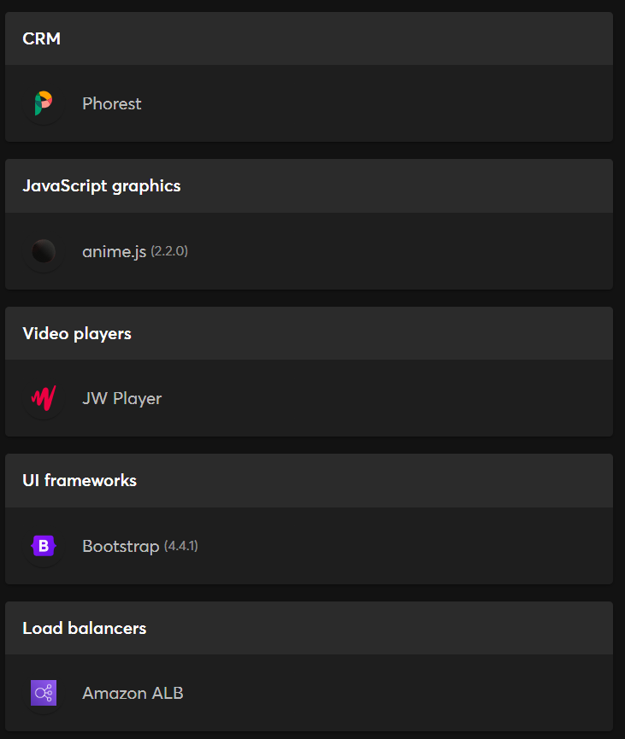
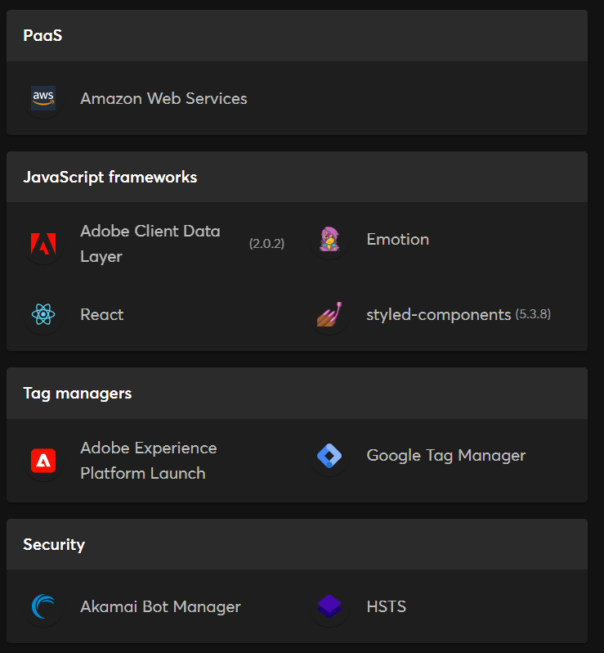
Task 3 – Website Platform Identification: Screenshots

Slide 8
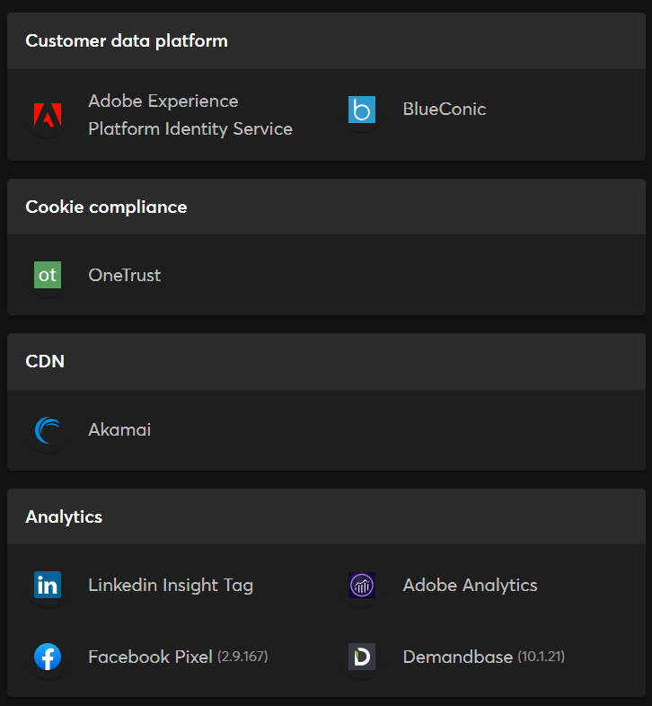
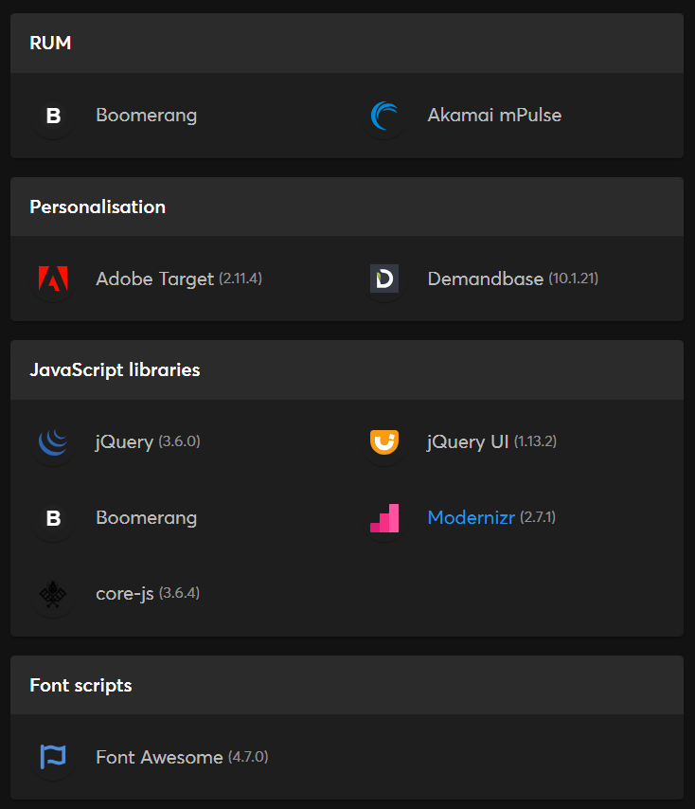
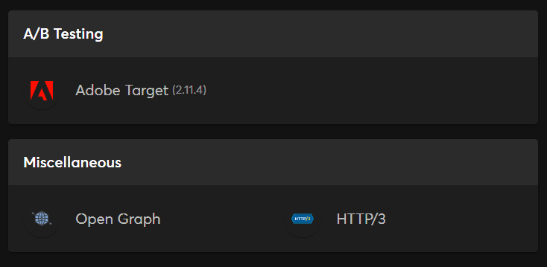
Task 3 – Website Platform Identification: Screenshots

Slide 9
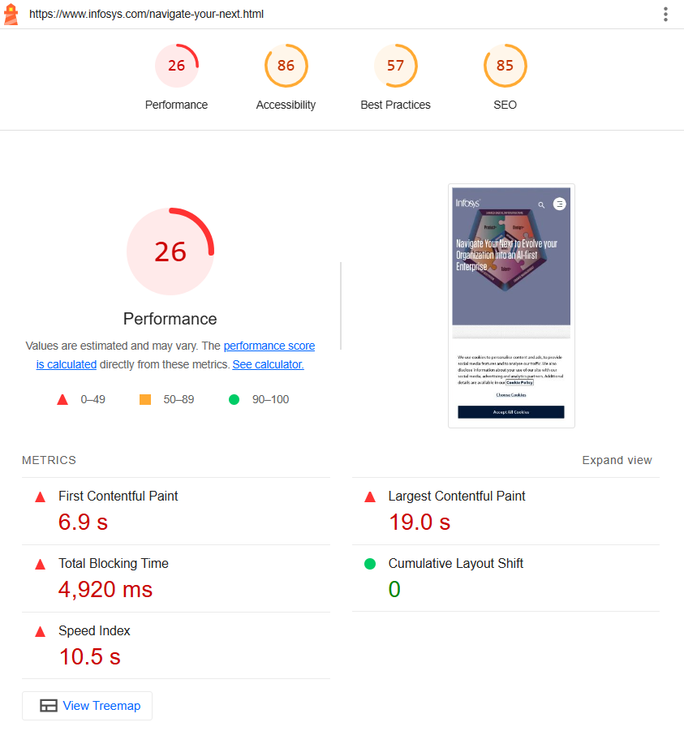
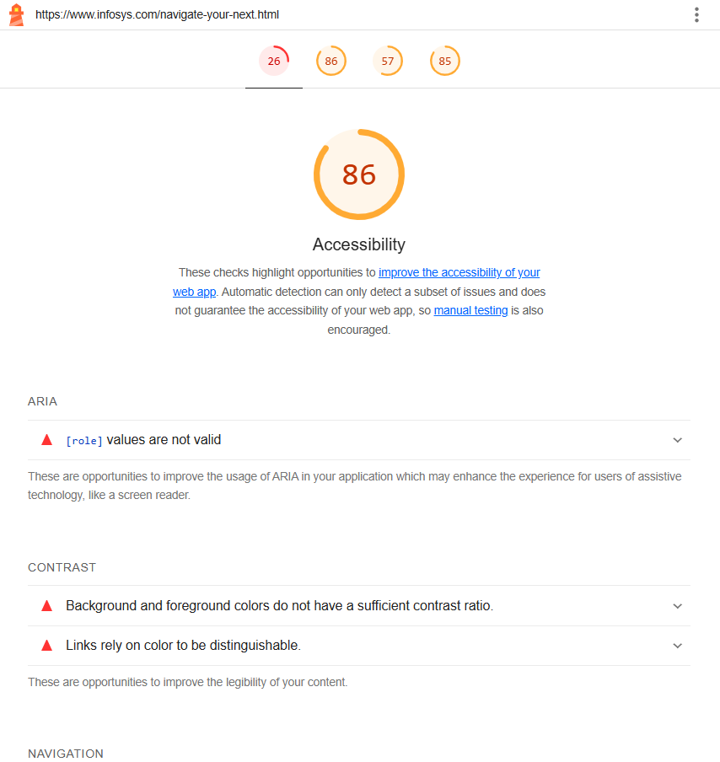
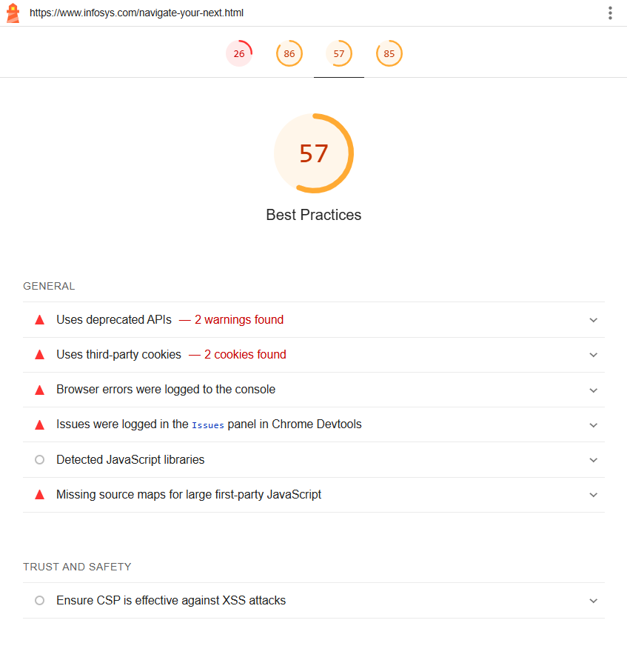
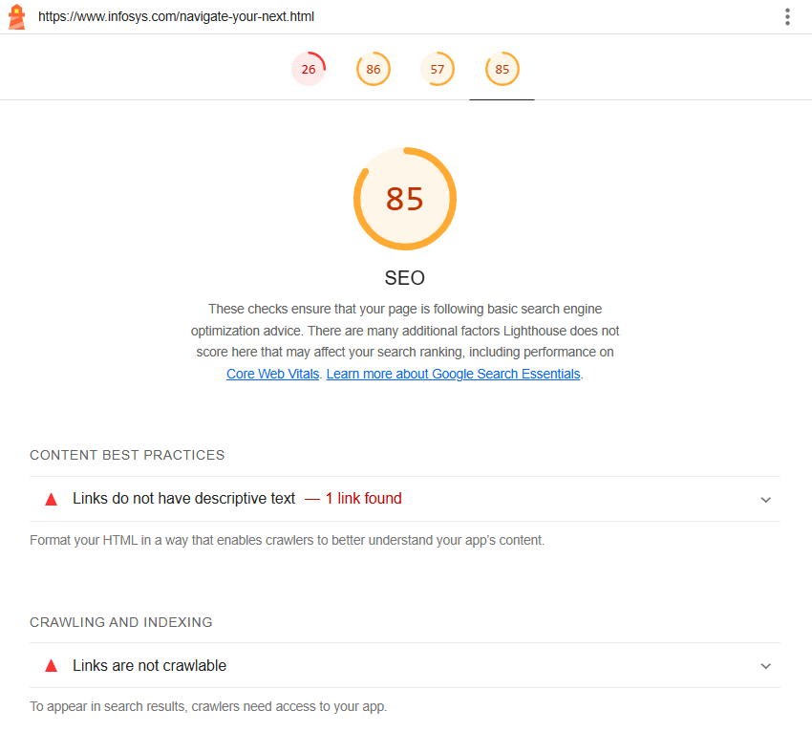
TASK 4 - Test the website's responsive design and mobile optimization (using lighthouse testing tool)
PAGE:NAVIGATE YOUR NEXT REPORT
https://googlechrome.github.io/lighthouse/viewer/?psiurl=https%3A%2F%2Fwww.infosys.com%2Fnavigate-your-next.html&strategy=mobile&category=performance&category=accessibility&category=best-practices&category=seo&locale=en-US&utm_source=lh-chrome-ext

Slide 10
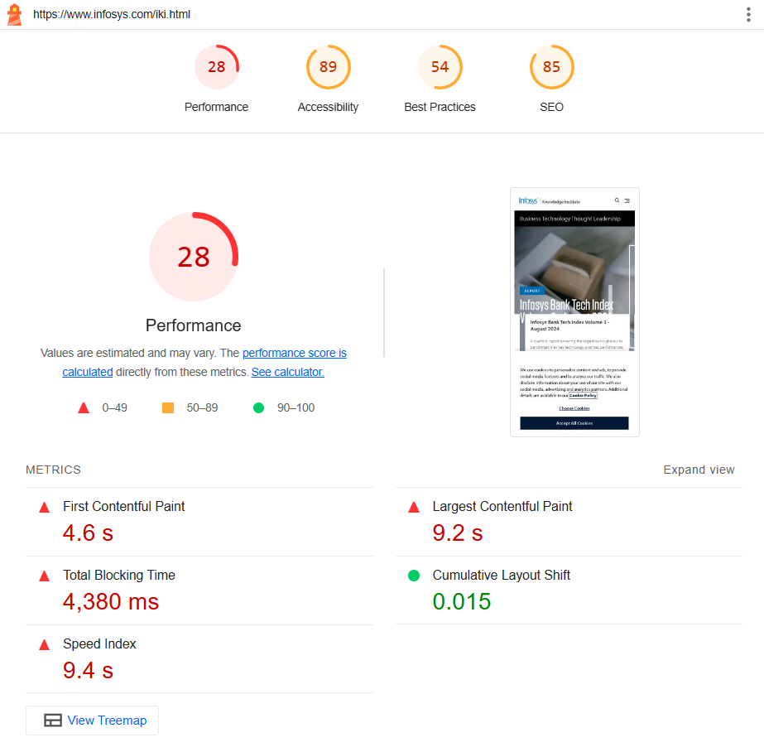
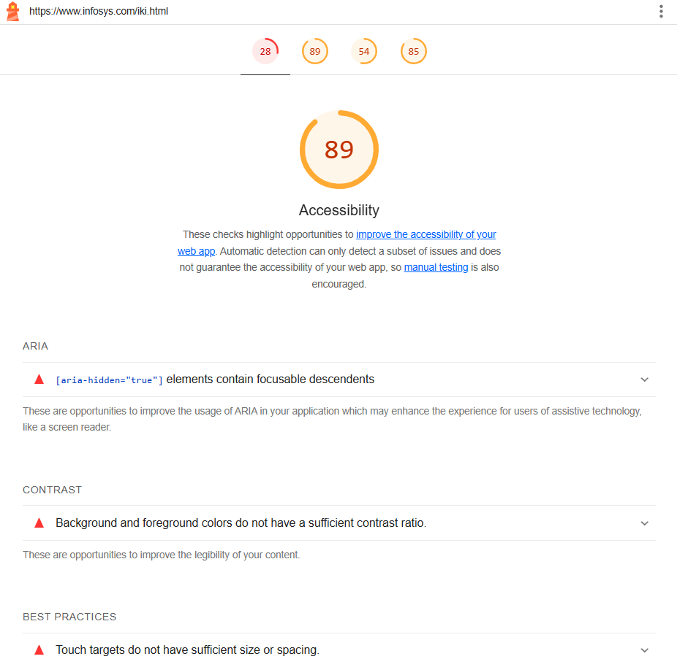
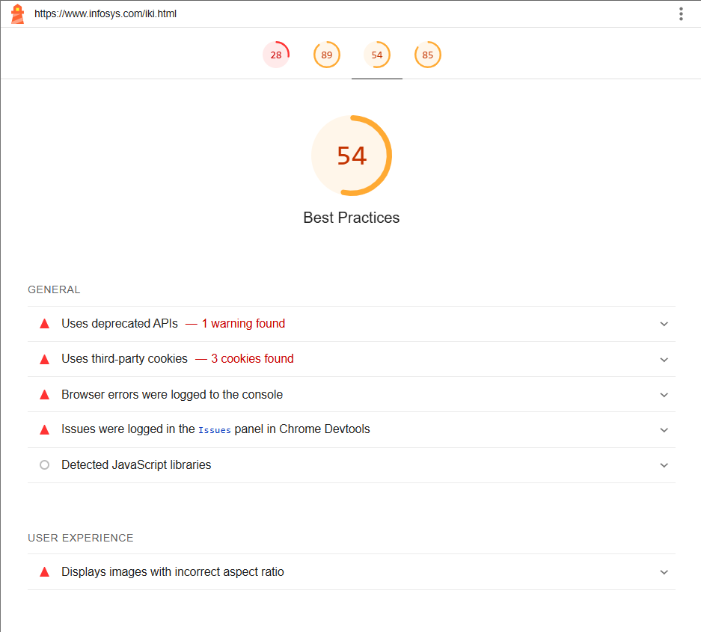
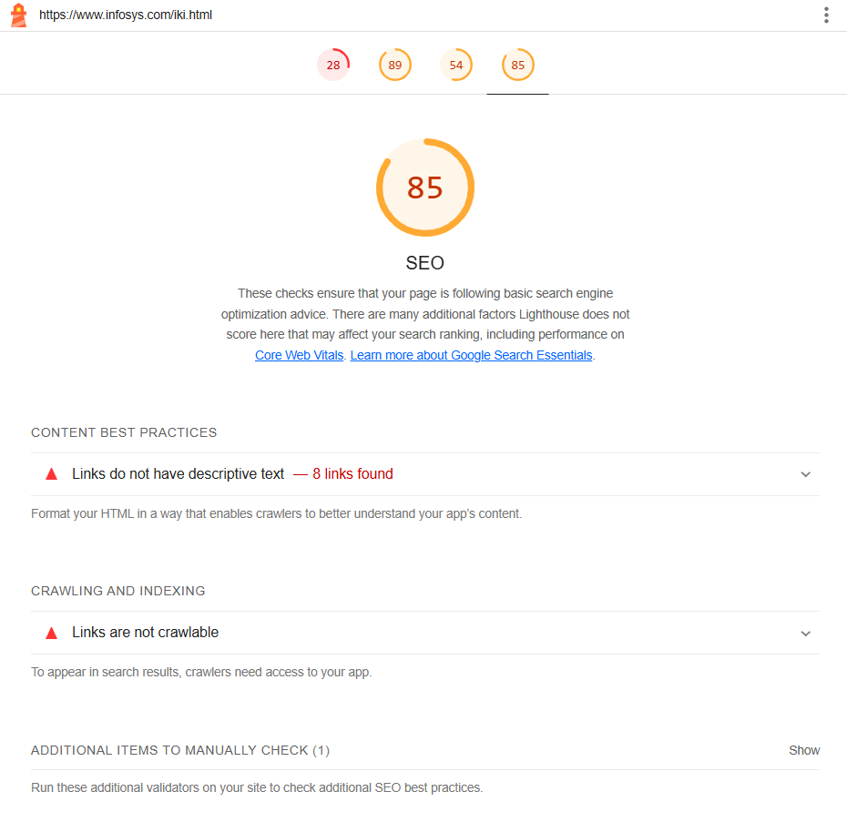
PAGE: INFOSYS KNOWLEDGE INSTITUTE REPORT
https://googlechrome.github.io/lighthouse/viewer/?psiurl=https%3A%2F%2Fwww.infosys.com%2Fiki.html&strategy=mobile&category=performance&category=accessibility&category=best-practices&category=seo&locale=en-US&utm_source=lh-chrome-ext

Slide 11
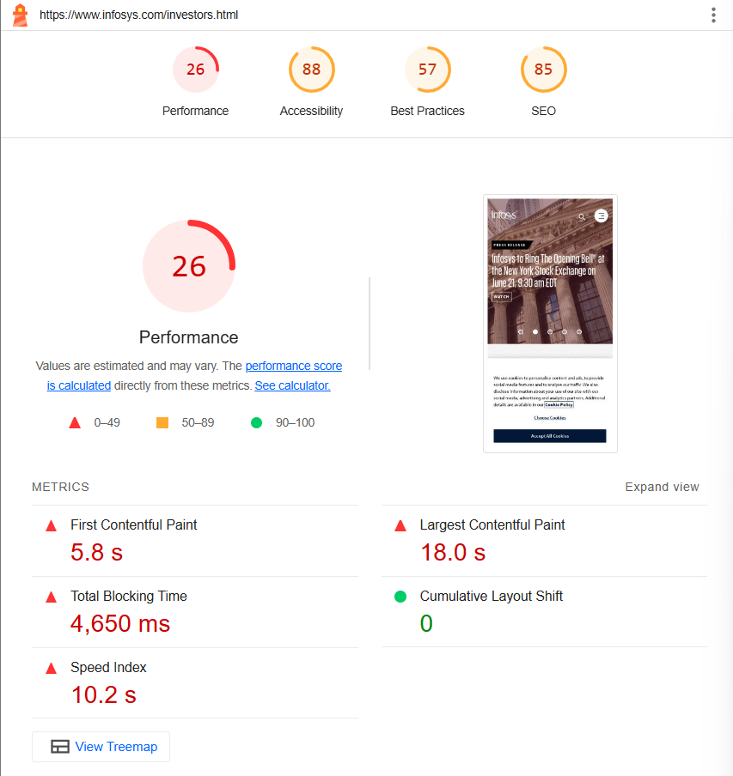
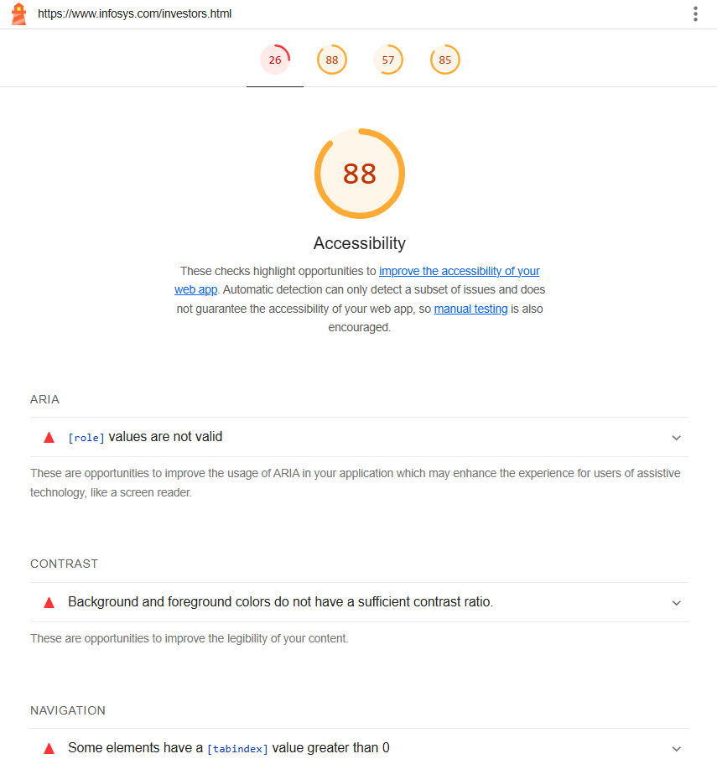
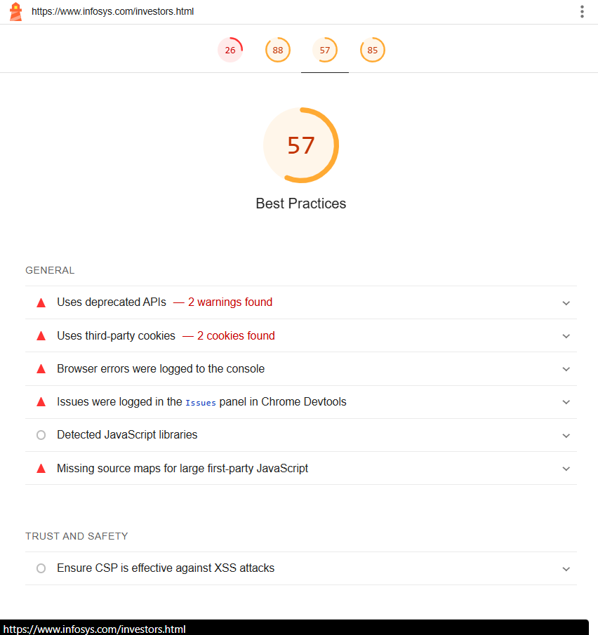
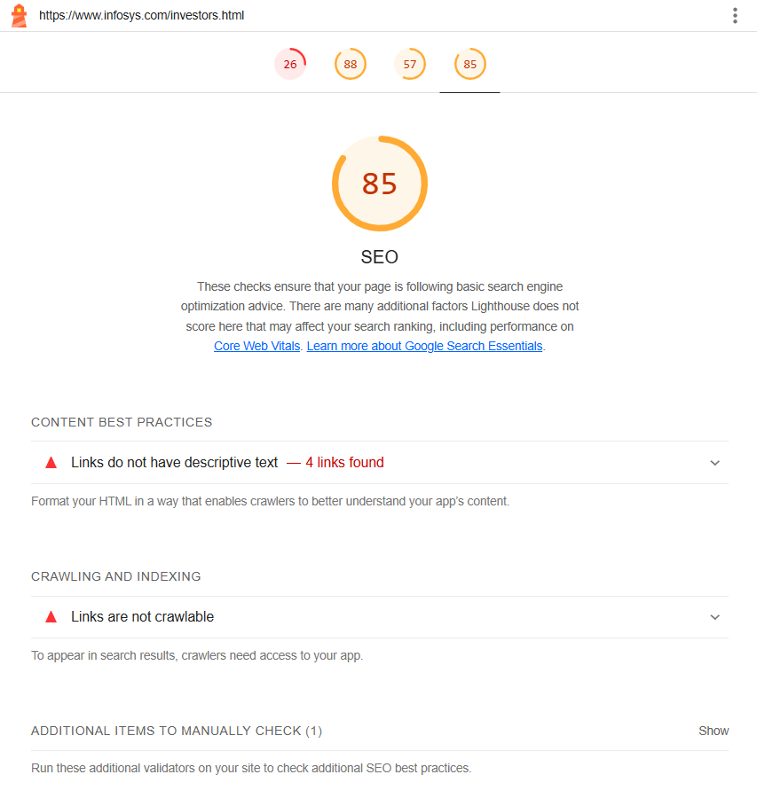
PAGE: INVESTORS REPORT
https://googlechrome.github.io/lighthouse/viewer/?psiurl=https%3A%2F%2Fwww.infosys.com%2Finvestors.html&strategy=mobile&category=performance&category=accessibility&category=best-practices&category=seo&locale=en-US&utm_source=lh-chrome-ext

Slide 12
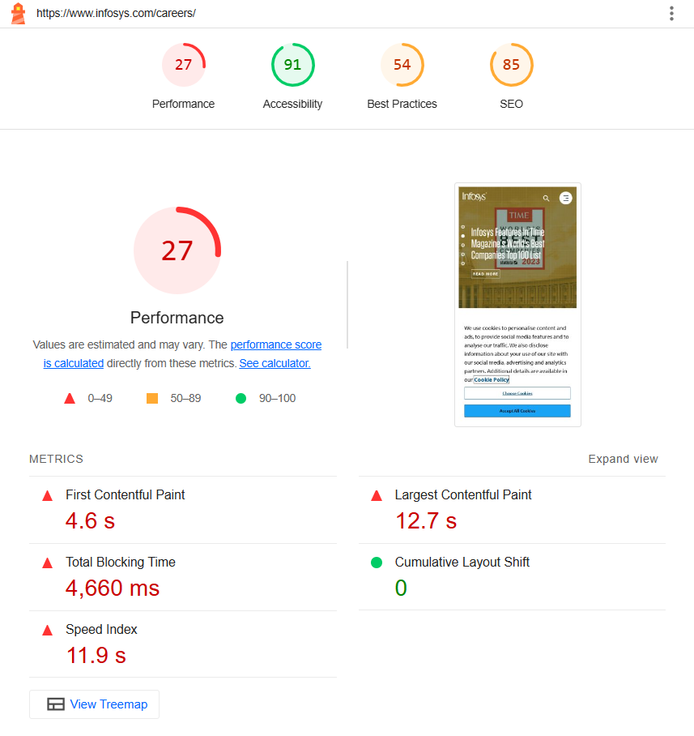
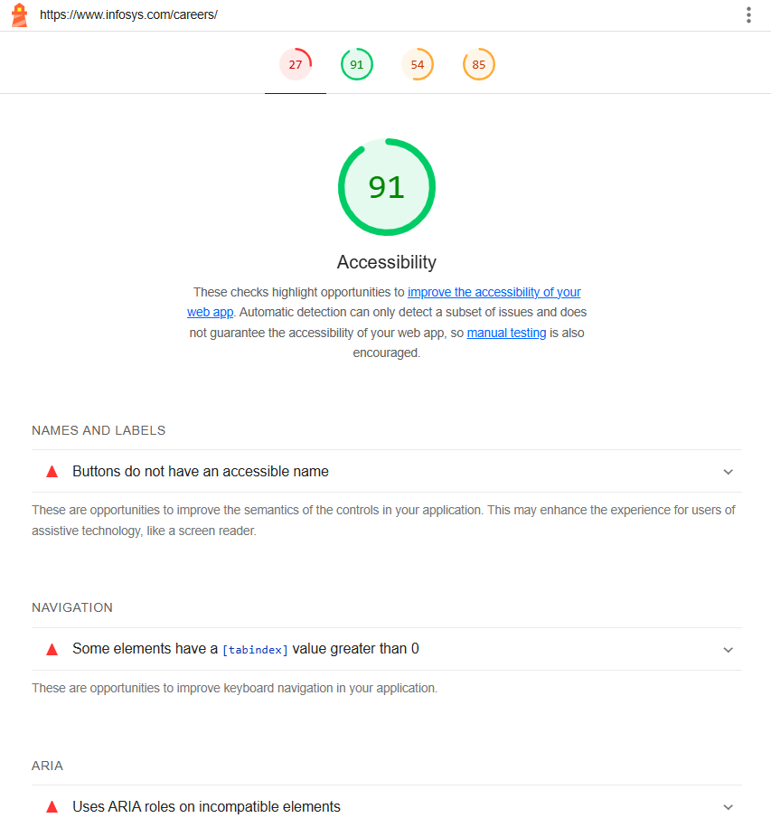
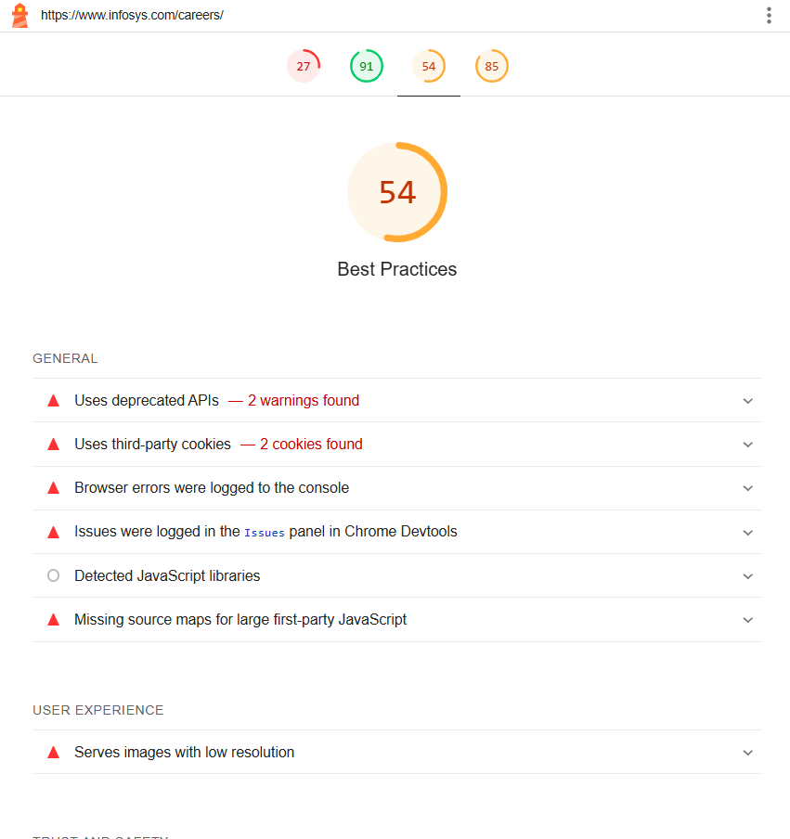
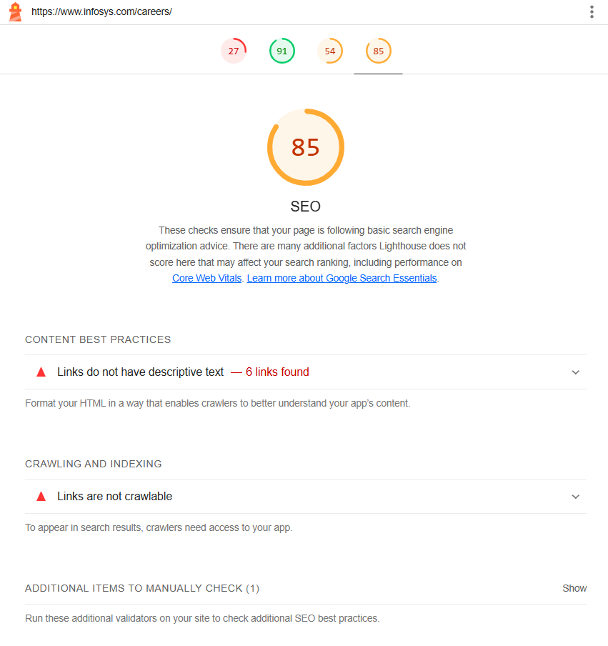
PAGE: CAREER REPORT
https://googlechrome.github.io/lighthouse/viewer/?psiurl=https%3A%2F%2Fwww.infosys.com%2Fcareers%2F&strategy=mobile&category=performance&category=accessibility&category=best-practices&category=seo&locale=en-US&utm_source=lh-chrome-ext

Slide 13
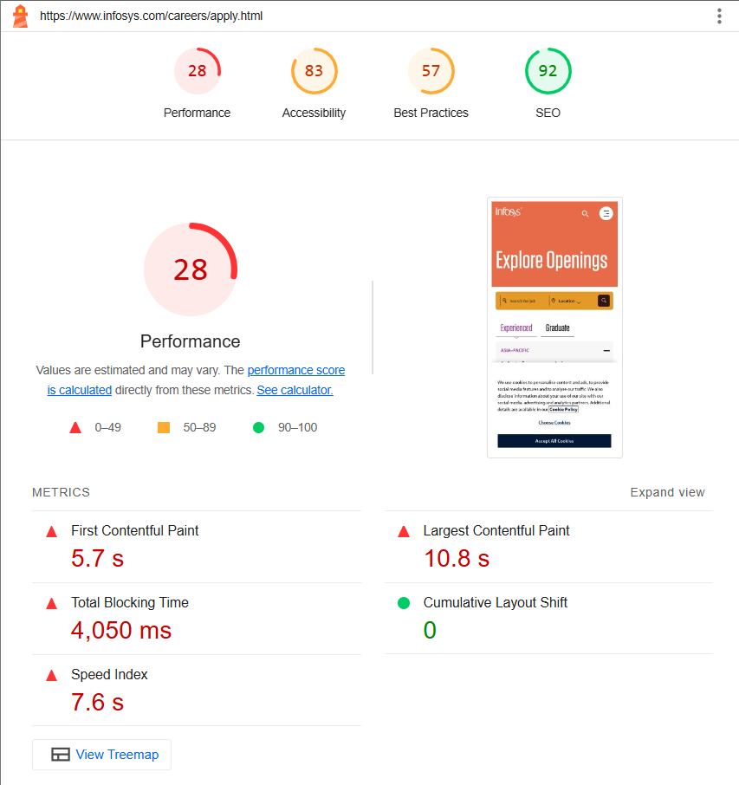
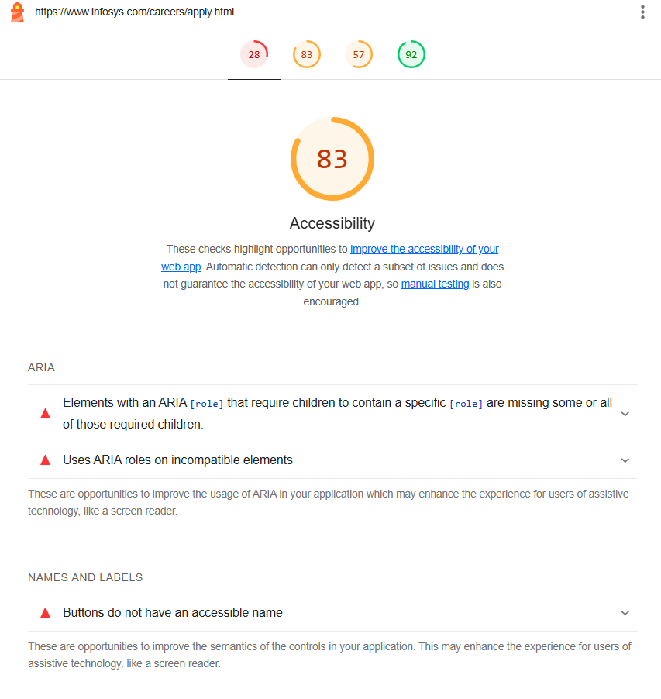
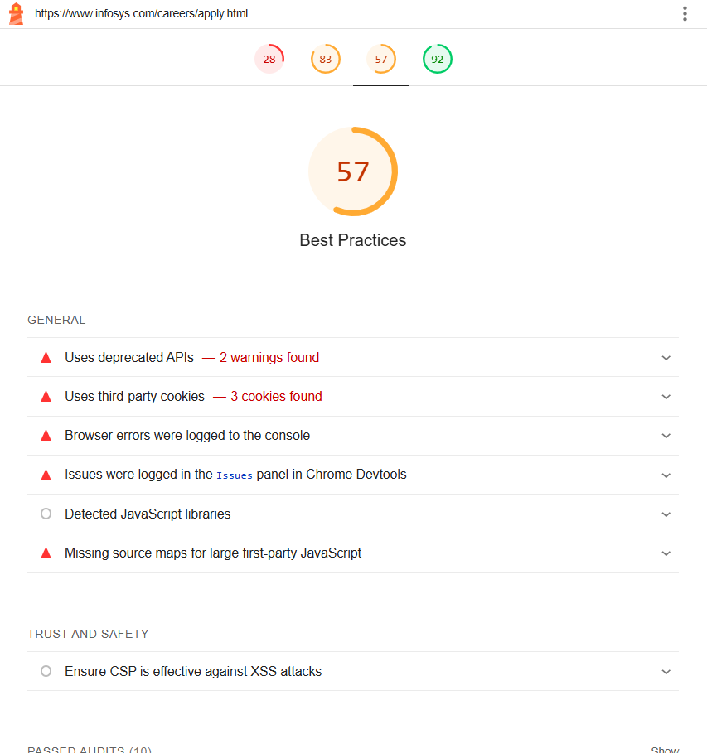
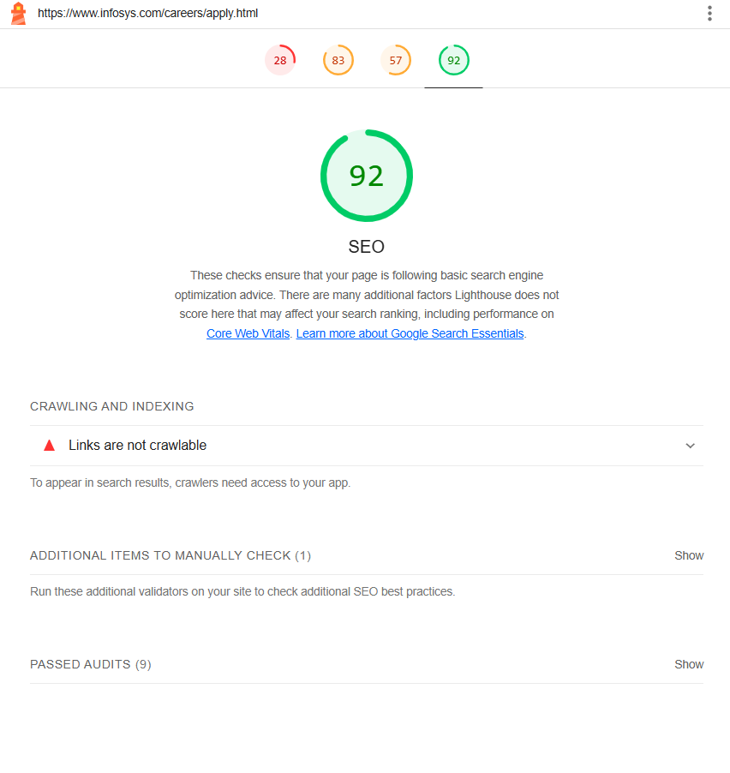
PAGE: APPLY NOW REPORT
https://googlechrome.github.io/lighthouse/viewer/?psiurl=https%3A%2F%2Fwww.infosys.com%2Fcareers%2Fapply.html&strategy=mobile&category=performance&category=accessibility&category=best-practices&category=seo&locale=en-US&utm_source=lh-chrome-ext

Slide 14
Task 5 – Website Mistakes Identification
Poor Navigation:
Ensure intuitive navigation with clear menus and navigation bars.
Use descriptive labels and categories to help users find what they're looking for quickly.
Avoid excessive nesting of menus or dropdowns, which can confuse users.
Slow Loading Times:
Optimize images and multimedia files to reduce loading times.
Minimize HTTP requests by combining CSS and JavaScript files.
Use caching and content delivery networks (CDNs) to speed up website performance.
Unresponsive Design:
Ensure your website is responsive and accessible across various devices and screen sizes.
Test your website on different browsers and devices to ensure compatibility.
Use responsive design frameworks like Bootstrap or Foundation to build mobile-friendly layouts.

Slide 15
Task 5 – Website Mistakes Identification
Inconsistent Branding:
Maintain consistency in branding elements such as colors, fonts, and logos across all pages.
Use a cohesive design theme that reflects your brand identity and values.
Avoid mixing conflicting design styles or themes that can confuse visitors.
Poor Readability:
Use legible fonts and font sizes for body text and headings.
Ensure sufficient color contrast between text and background for readability.
Break up long paragraphs into shorter, digestible chunks for easier reading.

Slide 16
Task 6 - Website Best Practices List
1. Simplify Navigation:
Use clear and intuitive navigation menus to help users easily find the information they need.
Limit the number of menu items and organize them logically to reduce cognitive load.
2. Prioritize Content Hierarchy:
Use visual hierarchy to emphasize important content and guide users' attention.
Use larger fonts, bolder colors, and strategic placement to highlight key messages and calls-to-action.
3. Optimize Readability:
Choose legible fonts and appropriate font sizes for both desktop and mobile devices.
Ensure sufficient contrast between text and background colors to enhance readability, especially for users with visual impairments.

Slide 17
Task 6 - Website Best Practices List
4.Optimize Images and Multimedia:
Use high-quality images and multimedia content to enhance visual appeal.
Optimize file sizes to minimize loading times and improve website performance.
5.Ensure Mobile Responsiveness:
Design websites with a mobile-first approach to ensure compatibility across various devices and screen sizes.
Use responsive design techniques to adapt layout and content based on screen resolution.

Slide 18
Task 7 - Landing Page Design
The Landing page was in another file.

Slide 19
Conclusion
For the project on "Crafting & Compelling Website Analysis, Audit, and Recommendations", the analysis of Infosys' website highlights key areas where improvements can enhance user experience, lead generation, and brand awareness. By focusing on refining the landing page design, streamlining navigation, optimizing for mobile responsiveness, and integrating strategic SEO techniques, Infosys can strengthen its digital presence and attract a more engaged audience. Implementing these recommendations will not only improve visitor retention but also drive higher conversion rates, ultimately aligning with the company's objectives of innovation and leadership in the IT services sector.

